Slide 1
SEBA ( সেবা) A NGO MANAGEMENT SYSTEM Presented by: Quest
Ashfaq Ali Shafin ID: 14.01.04.111
Irtiza Abir ID: 14.01.04.122
Abid Hasan Prottoy ID: 14.01.04.125

Slide 2
INTRODUCTION
What is NGO
Types Of NGO
Managing NGO of This Project

Slide 3
Motivation for this Project
Vast Opportunities
Solving Real Life Problem
Adequate Resource for Collection Data
Making Administrative Task Easier For The Staffs

Slide 4
Features
Web Based User Interface
Micro-Credit Activity Management
Social Activities Management
Social Awareness Management

Slide 5
Features
Registration Process
Activities Time Schedule
Previous Successful Activities

Slide 6
Feasibilities
Feasibilities
Technical
Economical
Operational
26/11/206
QUEST

Slide 7
Technical Feasibility
Hardware
Laptop & PC
Software
Open Source Software
Internet Connection
OS as Windows
Technology
Up to Date

Slide 8
Economical Feasibility
Availability of S/W & H/W
Low Budget
Data Collection & Information Gathering Cost
Technical Cost
Other Cost

Slide 9
Operational Feasibility
User Level
Amateur
User Interface
Efficient & Simple
Maintenance
Optimized & Short Run
Error Handling (User)
Proper Actions to Identify Errors

Slide 10
Cost Benefit Analysis
Cost & Benefit
Client Sided
Developer Sided

Slide 11
Cost Benefit Analysis (Client)
Costs
Benefits
Hardware Costs (Tangible)
Internet & Electrical Bill (Tangible)
Repair Cost (Tangible)
Other Cost (Tangible/Intangible)
Web Based User Interaction (Tangible)
Customer Satisfaction (Intangible)
Incensement of Customer (Tangible)
Higher Brand Value (Intangible)

Slide 12
Cost Benefit Analysis (Developer)
Costs
Benefits
Programmer’s Time (Tangible)
Collecting Data & Information (Tangible)
System Settings (Tangible)
Internet & Electricity Bill (Tangible)
New Experience (Intangible)
Real Life Problem Solving (Intangible)
Payment (Tangible)

Slide 13

Cost Benefit Analysis (Present Value)
$$PV=\frac{FV}{{\left(1+i\right)}^{n}}$$
FV = Future Value
PV = Present Value
i = interest rate in %
n = time in year

Slide 14
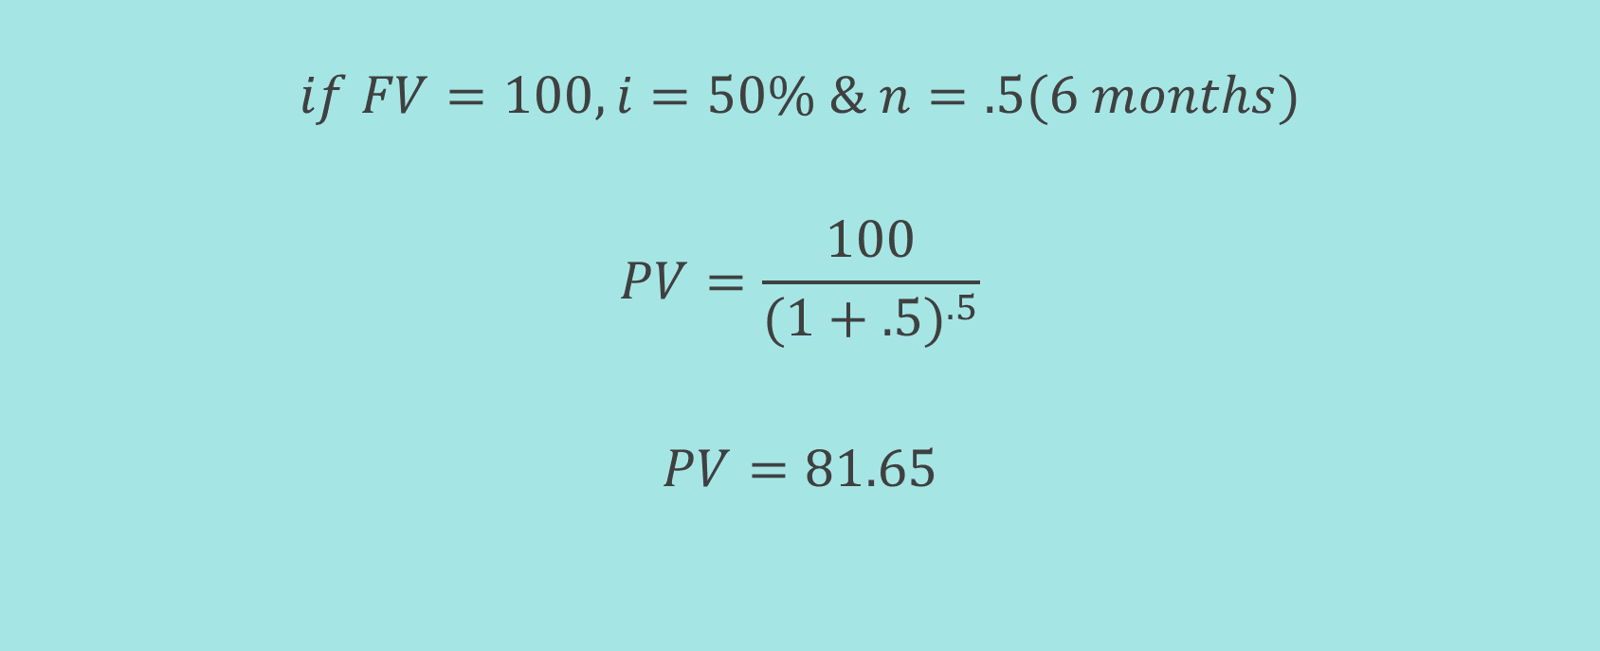
Cost Benefit Analysis (Present Value)
$$if FV=100, i=50\% \& n=.5(6 months)$$
$$PV=\frac{100}{{(1+.5)}^{.5}}$$
$$PV=81.65$$

Slide 15
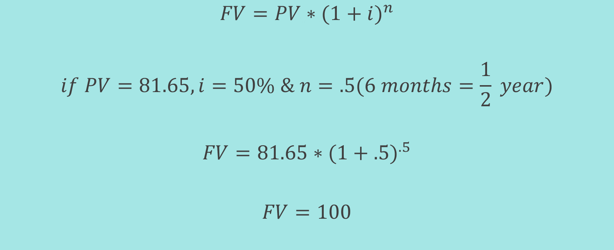
Cost Benefit Analysis (Future Value)
$$FV=PV∗{(1+i)}^{n}$$
$$if PV=81.65, i=50\% \& n=.5(6 months=\frac{1}{2} year)$$
$$FV=81.65∗{(1+.5)}^{.5}$$
$$FV=100$$

Slide 16
Project Scheduling
Analysis
Planning
Construction
Deployment

Slide 17
Analysis
Activity | Description | Precedence | Time (in week/s)
1 | Job Specification | None | 1
2 | Research on Market | 1 | 1
3 | Requirement Gathering | 2 | 1
4 | Project Initiation | 1,2 | 1

Slide 18
Planning
Activity | Description | Precedence | Time (in week/s)
5 | System Design | 4 | 1
6 | Database Design | 5 | 1
7 | Mock-up Database Implementation | 6 | 1

Slide 19
Construction
Activity | Description | Precedence | Time (in week/s)
8 | User Interface Designing | 5 | 2
9 | Admin Panel Designing | 5 | 1
10 | Coding | 5,6 | 4

Slide 20
Deployment
Activity | Description | Precedence | Time (in week/s)
11 | Testing | 8,9,10 | 2
12 | Feedback & Releasing | 11 | 1

Slide 21
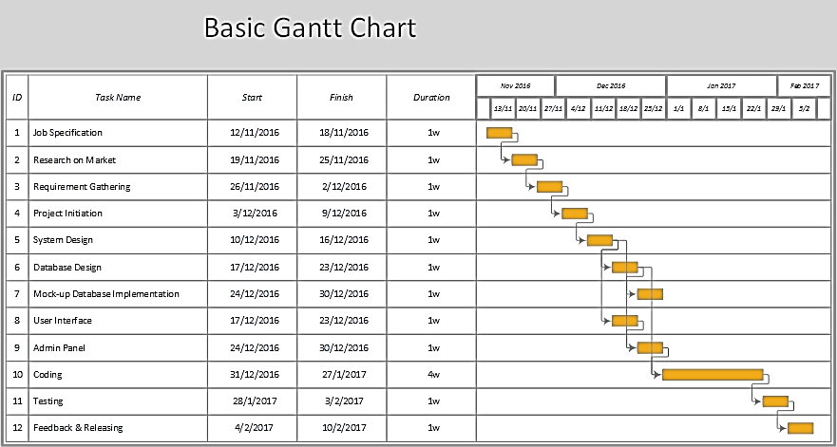
Gantt Chart

Slide 22
Risk Analysis
Backup for Database
Secured Database & Registration Form
Timing Commitment
Hardware Backup

Slide 23
How about a Question !!!

